Slide 1
Linux Device Model

Slide 2
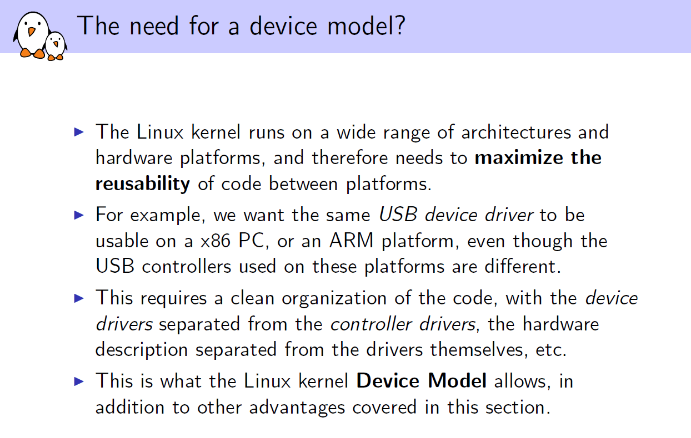

Slide 3
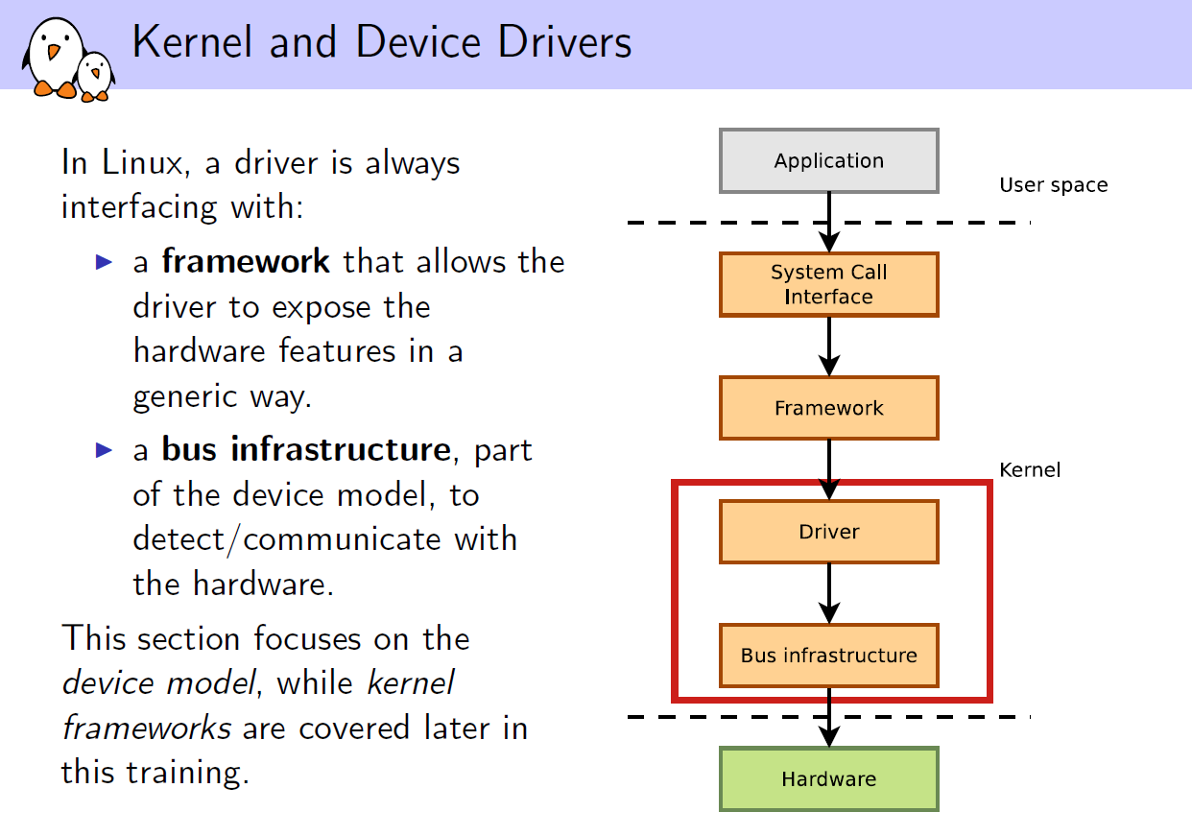

Slide 4
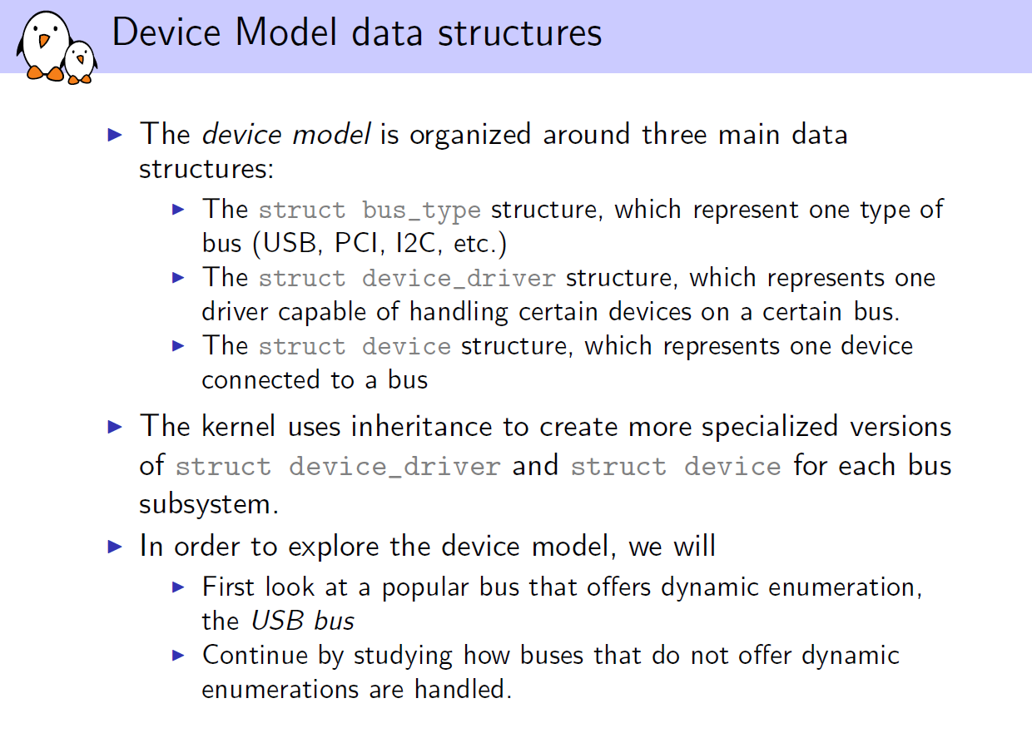

Slide 5
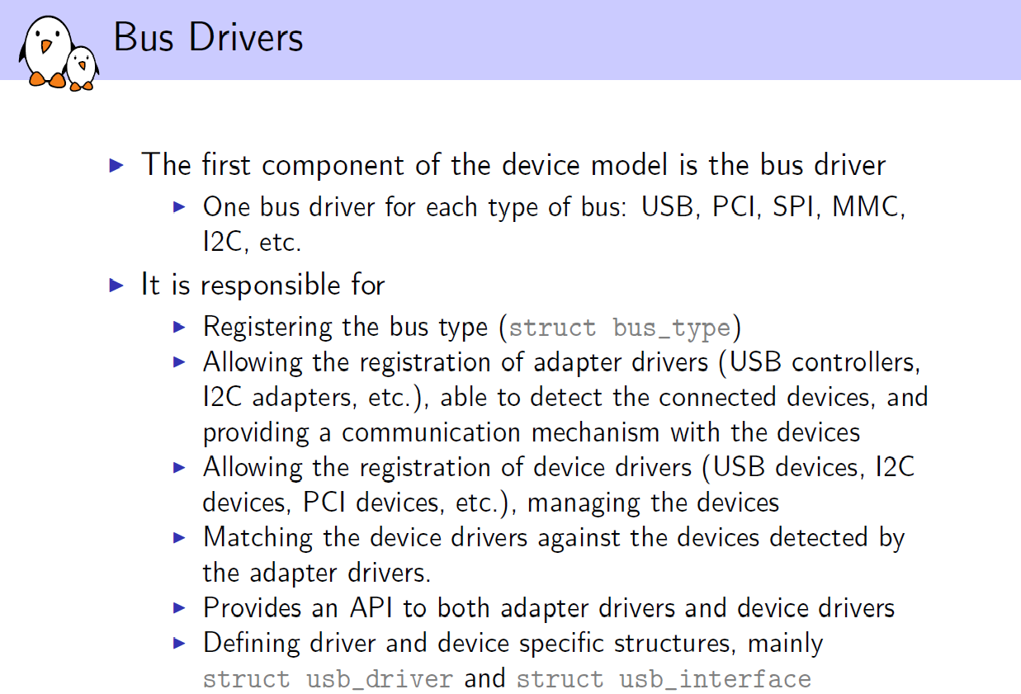

Slide 6
Sysfs
The kernel provides a representation of its model in userspace through the sysfs virtual file system. It is usually mounted in the /sys directory and contains the following subdirectories:
block - all block devices available in the system (disks, partitions)
bus - types of bus to which physical devices are connected (pci, ide, usb)
class - drivers classes that are available in the system (net, sound, usb)
devices - the hierarchical structure of devices connected to the system
firmware - information from system firmware (ACPI)
fs - information about mounted file systems
kernel - kernel status information (logged-in users, hotplug)
module - the list of modules currently loaded
power - information related to the power management subsystem
The sysfs information is found in files that contain an attribute. Some standard attributes (represented by files or directories with the same name) are as follows:
dev - Major and minor device identifier. It can be used to automatically create entries in the /dev directory
device - a symbolic link to the directory containing devices; It can be used to discover the hardware devices that provide a particular service (for example, the ethi PCI card)
driver - a symbolic link to the driver directory (located in /sys/bus/*/drivers )

Slide 7
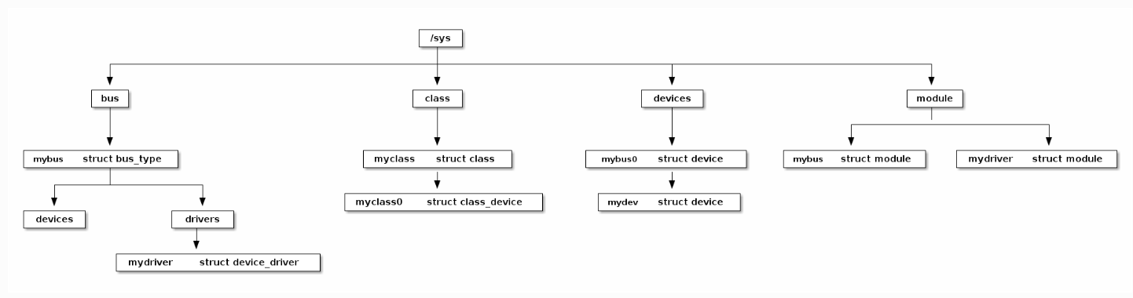
Linux Device Model provides a number of structures to ensure the interaction between a hardware device and a device driver. The whole model is based on kobject structure. Hierarchies are built using this structure and the following structures are implemented:
struct bus_type
struct device
struct device_driver

Slide 8
Udev (userspace /dev) is a Linux sub-system for dynamic device detection and management, since kernel version 2.6. It’s a replacement of devfs and hotplug.
It dynamically creates or removes device nodes (an interface to a device driver that appears in a file system as if it were an ordinary file, stored under the /dev directory) at boot time or if you add a device to or remove a device from the system. It then propagates information about a device or changes to its state to user space. The udev daemon, systemd-udevd (or systemd-udevd.service) communicates with the kernel and receives device uevents directly from it each time you add or remove a device from the system, or a device changes its state.
Udev is based on rules – it’s rules are flexible and very powerful. Every received device event is matched against the set of rules read from files located in /lib/udev/rules.d and /run/udev/rules.d.
udevadm is the administrative utility for udev, the userspace device manager in Linux. When hardware or kernel devices are added/removed (e.g. USB drive inserted, network interface appears, kernel module creates a /dev node), the kernel emits uevents. The udevd daemon receives those, applies rules, creates device nodes under /dev, and may run user scripts or start systemd units. udevadm monitor lets you observe those events live, helping you debug device behavior, kernel module uevents, and udev rule matching. You can use the udevadm command to query the udev database and sysfs. udev might be too heavy-weight for some embedded systems, the udevd daemon staying in the background waiting for events. BusyBox provides a simpler alternative called mdev, available by enabling the MDEV configuration option.
# udevadm info --query=path --name=/dev/sda
/devices/pci0000:00/0000:00:0d.0/host0/target0:0:0/0:0:0:0/block/sda
# udevadm info --query=property –name=/dev/sda
#udevadm test /sys/bus/pci/devices/0000\:03\:00.0
#udevadm test /sys/class/net/enp1s0
#udevadm monitor --udev –subsystem-match=usb
#sudo udevadm monitor --kernel

